Slide 1

Sparse Matrix
Mr. Yogesh Sharma
Assistant professor
cse, MAIT

Slide 2
Sparse Arrays/ Matrix
A matrix is sparse if many of its elements are zero/ Min. Non-Zero elements.
A matrix that is not sparse is dense.
The boundary is not precisely defined.
Diagonal and tridiagonal matrices are sparse.
We classify triangular matrices as dense.
Min. traversal time/ Scanning time.
Two possible representations
Array, Linked list

Slide 3
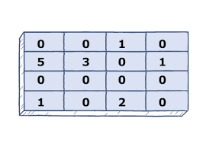
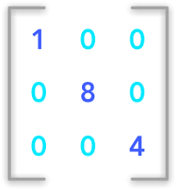
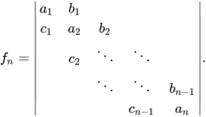
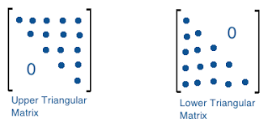
Sparse Matrix
Diagonal Matrix
Tridiagonal Matrix
Triangular Matrix

Slide 4
Array Representation of Sparse Matrix
The nonzero entries may be mapped into a One-D array in row-major order
To reconstruct the matrix structure, need to record the row and column each nonzero comes from.

Slide 5
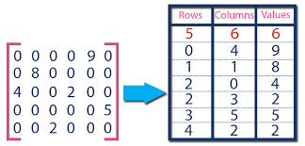
3-D representation of an Sparse matrix

Slide 6
// Generating result matrix
int k = 0;
for (int row = 0; row < 5; row++)
for (int column = 0; column < 6; column++)
if (sparseMatrix[row][column] != 0)
{
resultMatrix[0][k] = row;
resultMatrix[1][k] = column;
resultMatrix[2][k] = sparseMatrix[row][column];
k++;
}
// Displaying result matrix
cout<<"Triplet Representation : "<<endl;
for (int row=0; row<3; row++)
{
for (int column = 0; column<size; column++)
cout<<resultMatrix[row][column]<<" ";
cout<<endl;
}
return 0;
}

Slide 7
// Displaying result matrix
cout<<"Triplet Representation : "<<endl;
for (int row=0; row<3; row++)
{
for (int column = 0; column<size; column++)
cout<<resultMatrix[row][column]<<" ";
cout<<endl;
}
return 0;
}

Slide 8
Linked Representation of Sparse Matrix

Slide 9
Sparse Matrix Linked list representation
Three Structures
Head Node
Row Node
Column Node
TR | TC | TNZ | .
First Row
RN | PNR | PC
Pointer to Column
CN | NZV | PNC
Pointer to next column in the same row that has non- zero values

Slide 10
r0 0 1 0 0
r1 5 0 4 0
r2 0 2 0 3
r3 0 3 0 0
c0 c1 c2 c3
4 | 4 | 6 | .
0 | 1
1 | 1 | X
1 | 2
0 | 5
2 | 4 | X
2 | 3
1 | 2
3 | 3 | X
3
1 | 3 | X

